Slide 1

Project On
Advanced GPA Calculator
Using MATLAB GUI
Islamic University of Technology (IUT)
Boardbazar, Gazipur
Project By
Md. Ashaduzzaman Niloy
160021002
Md. Sayed Hasan Rifat
160021024
EEE 4416
October 2018

Slide 2
Advanced GPA Calculator
Using MATLAB GUI
ABSTRACT
The main concept of the project was to develop a graphical user interface to calculate the Grade Point Average. But unlike the projects done on this concept before, we thought of developing a GUI that is user friendly for both Teachers and Students.
Also we were concerned about the flexibility of the GUI, so that it can be used to calculate the GPA of different semester and of different faculties.

Slide 3
Advanced GPA Calculator
Using MATLAB GUI
Concept Breakdown
Well, in GUI designing, we’ve thought of creating three user panels. They are,
Course Registration
Batch Mode Calculation
Individual Mode Calculation

Slide 4
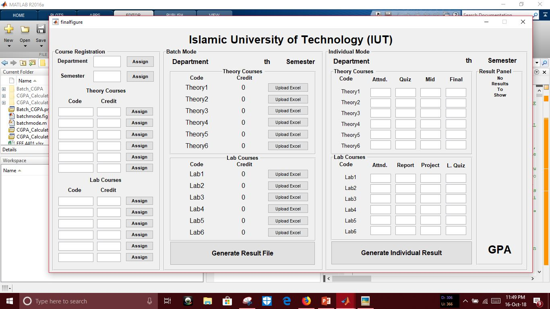
Advanced GPA Calculator
Using MATLAB GUI
Course Registration
We have to fill the text boxes assigned for Course Code and Credits and then we have to click “Assign” pushbutton

Slide 5
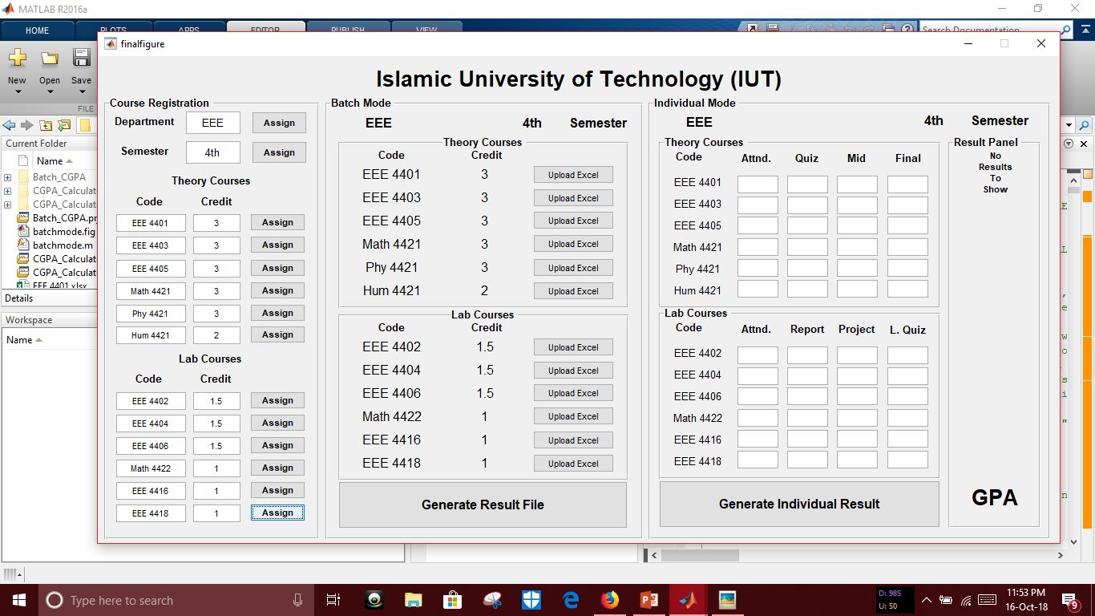
Advanced GPA Calculator
Using MATLAB GUI
Course Registration
In this way the course code will be available as String and the credit point will be available as Double to the whole gui function

Slide 6
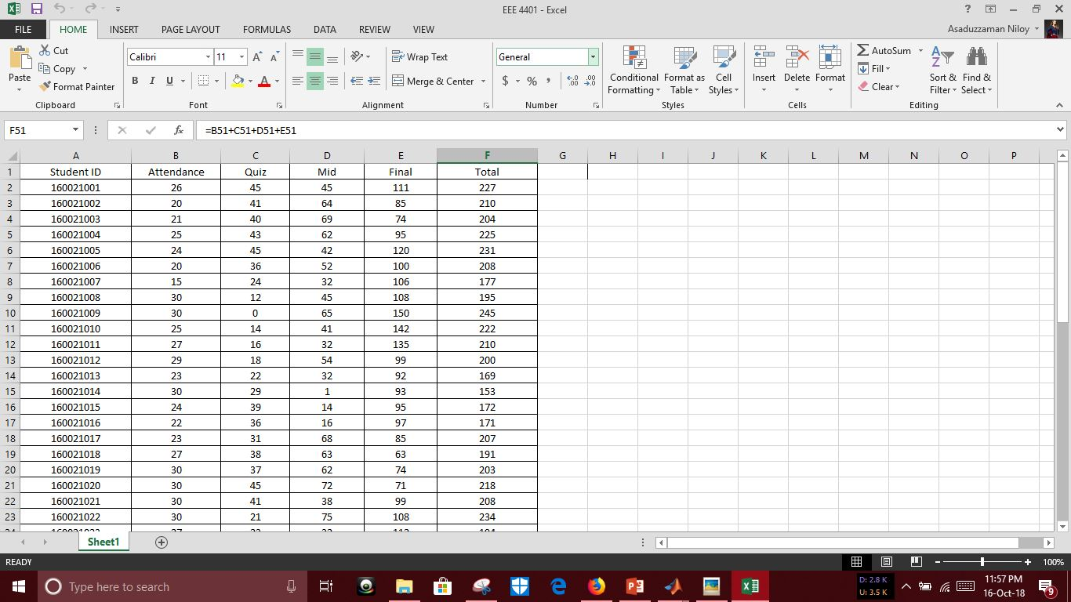
Advanced GPA Calculator
Using MATLAB GUI
Batch Mode Calculation
In Batch Mode,
the user have to upload the excel file produced for each individual subject by pushing Upload Excel button.
The Excel file will contain the marks a student has obtained throughout the semester

Slide 7
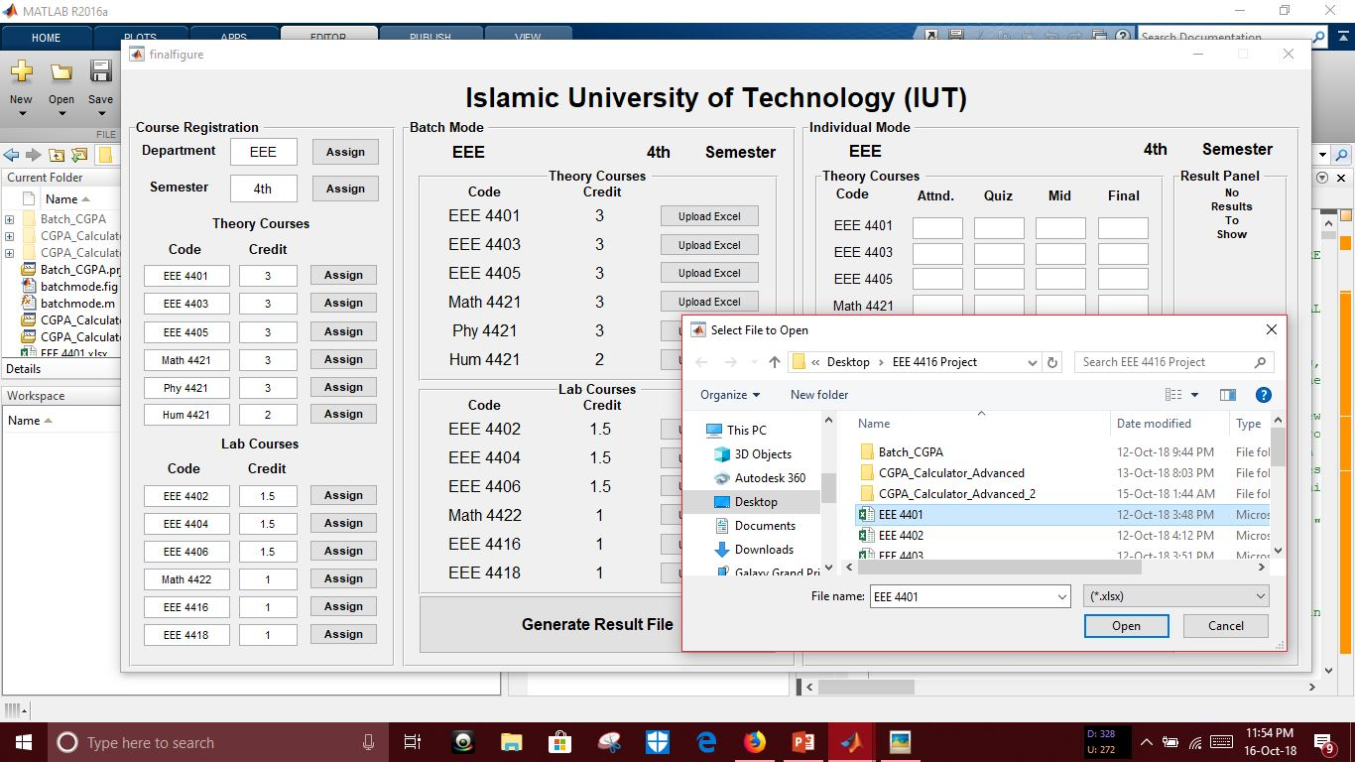
Advanced GPA Calculator
Using MATLAB GUI
Batch Mode Calculation
Uploading this excel file will make the excel datas available to both MATLAB Workspace and GUI for further calculation

Slide 8
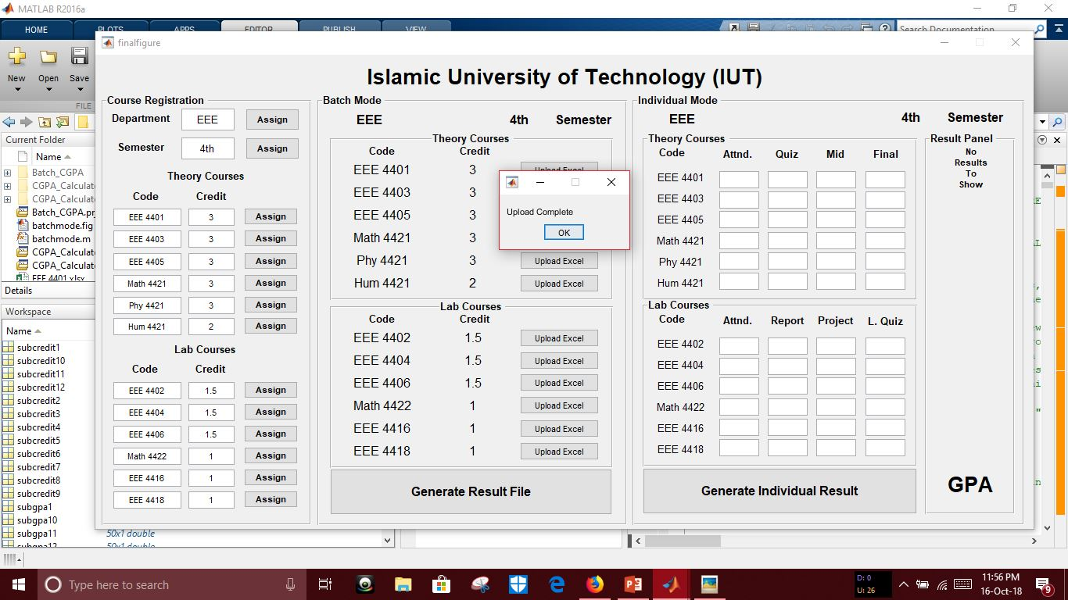
Advanced GPA Calculator
Using MATLAB GUI
Batch Mode Calculation
Uploading this excel file will make the excel datas available to both MATLAB Workspace and GUI for further calculation

Slide 9
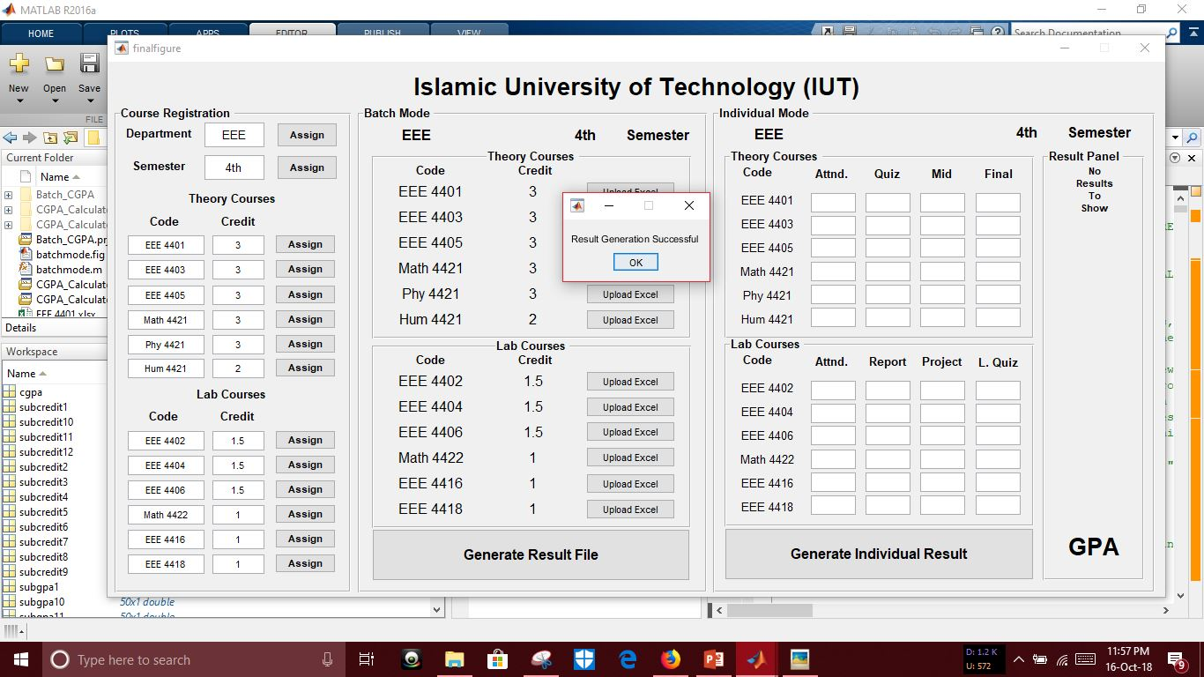
Advanced GPA Calculator
Using MATLAB GUI
Batch Mode Calculation
Then the user have to click “Generate Result File” pushbutton to generate an excel file containing all the GPA’s of all the students

Slide 10
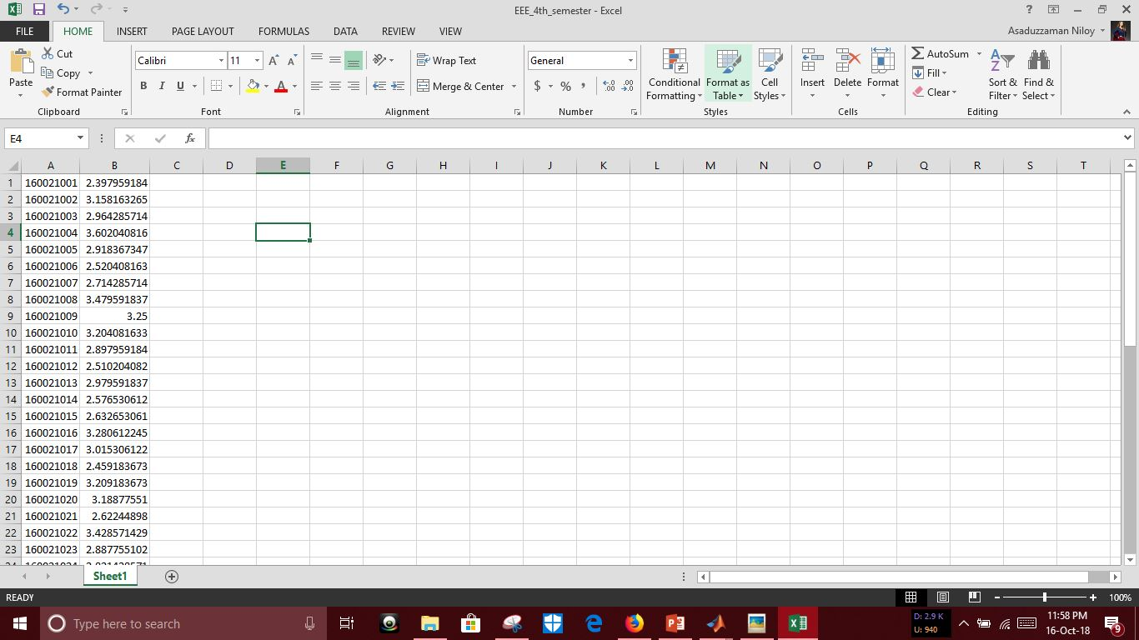
Advanced GPA Calculator
Using MATLAB GUI
Batch Mode Calculation
This process is done by calculating all the uploaded excel datas with respect to the credit input the user has given.
Here you can see the generated result file containing the final GPA of every student in that semester

Slide 11
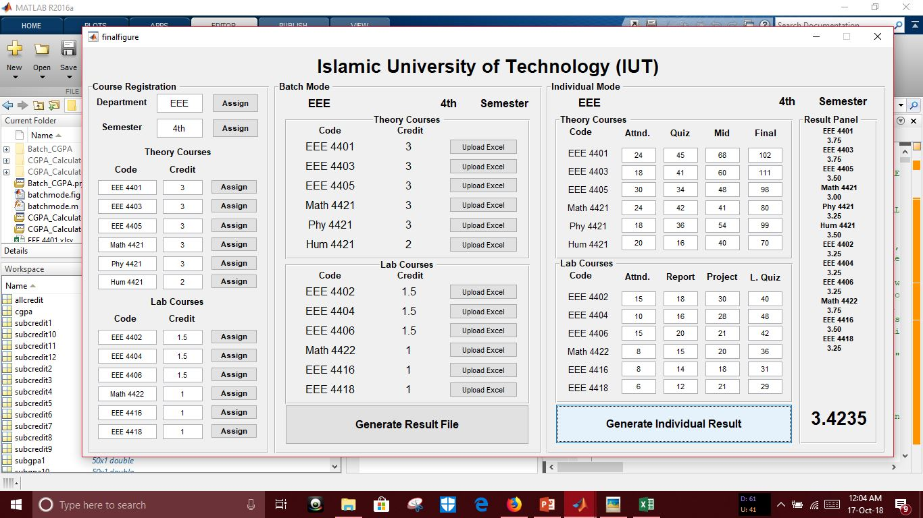
Advanced GPA Calculator
Using MATLAB GUI
Individual Mode Calculation
The individual mode is much simpler and requires less calculation.
The user has to manually input the datas in the assigned text boxes

Slide 12
Advanced GPA Calculator
Using MATLAB GUI
Individual Mode Calculation
Clicking the “Generate Individual Result” pushbutton, the program will compute the subject wise marks input and the previously registered credit, will show per subject gpa and total gpa.

Slide 13
Advanced GPA Calculator
Using MATLAB GUI
Discussion & Conclusion
The output of the operations will be of Two types,
1. Excel file: Contains ALL Student GPA’s
2. GUI Result Panel: Contains Individual (Subjectwise & Total) GPA’s

Slide 14
Advanced GPA Calculator
Using MATLAB GUI
Discussion & Conclusion
The advantage of this program is, it can do huge amount of calculation that requires a very bunch of time in a single gui along with the normal individual operations.
The disadvantage of this particular gui function built by this project group is, due to very much complexity of the calculations, any number of inputs less than 12 leads to a stoppage of the run. So the user must register the pre-defined number of courses in gui.

Slide 15
Thank You

